Slide 1
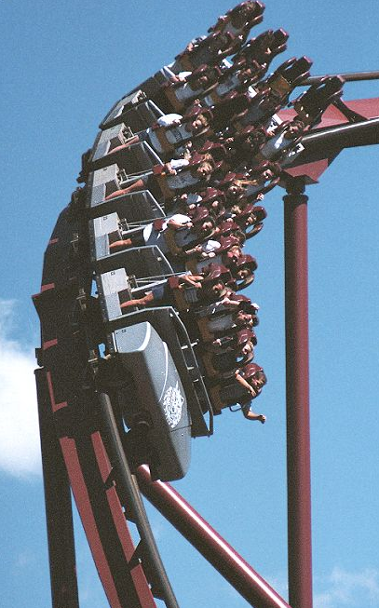
Physics 2048, General Physics A
Prof. Stephen Hill – Recitations Sections 5 & 6
An Introduction to Mechanics, Waves and Thermodynamics
Calculus and Trigonometry will be used (MAC 2311 a pre-requisite)
Course leader:
Prof. I. Wiedenhöver, KEN217, iwiedenhoever@fsu.edu
Recitation Sections 3 & 4:
Prof. H.-K. Ng, KEN416, hkng@fsu.edu
My coordinates:
Most of the time, I reside at the MagLab on the SW Campus (644-1647)
I will usually be on the main campus Mon/Wed mornings, KEN310 (645-8793)
fs.magnet.fsu.edu/~shill/
shill@magnet.fsu.edu

Slide 2
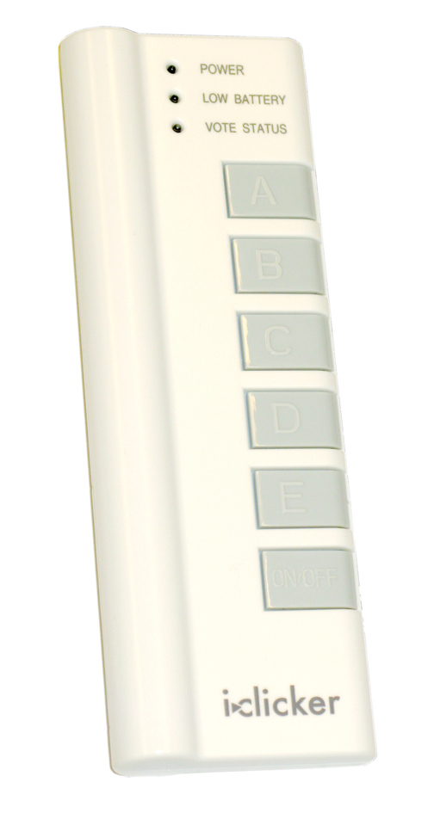
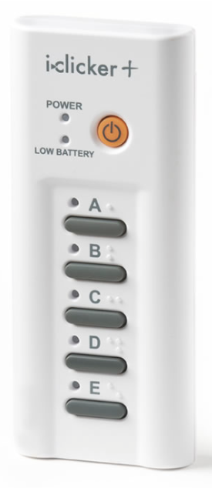
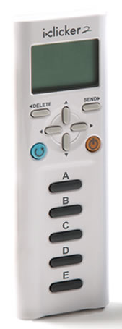
Physics 2048C: Lectures Tue/Thu
Lecturing: outline of concepts, simple derivations of formulas, example problems, connections between concepts and the real world around us…
… and some great demonstrations
iclicker quizzes
Approximately every lecture
Credit for participation and answers
Six 20 minute Mini-Exams (see syllabus)
First mini-exam NEXT WEEK! (Thu., Jan. 19th)
One in-class mid-term exam (1h 15m)
Thursday March 2nd
Purchase, then register:
via Blackboard

Slide 3
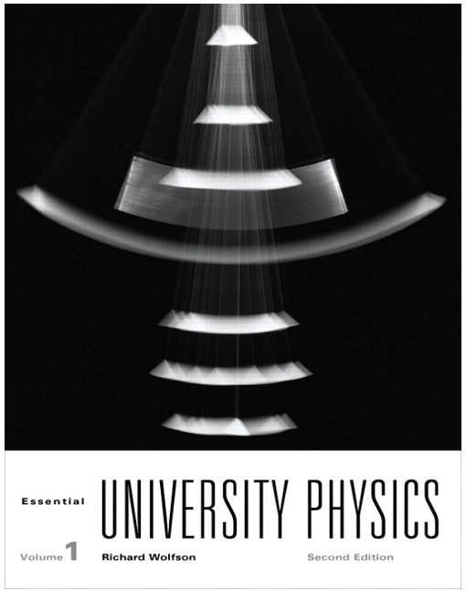
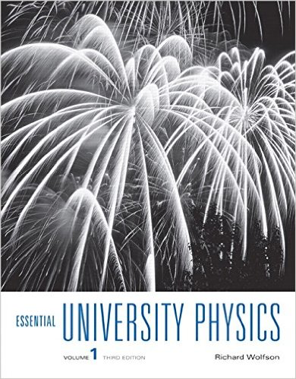
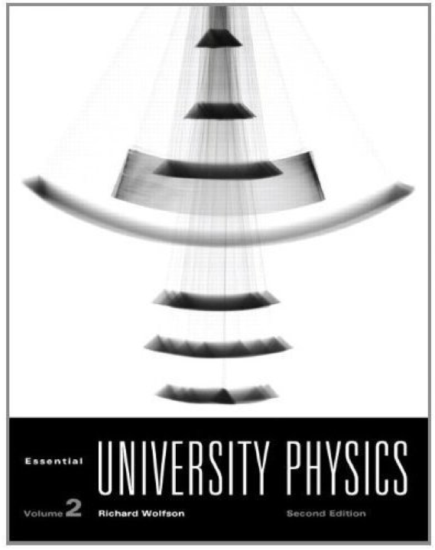
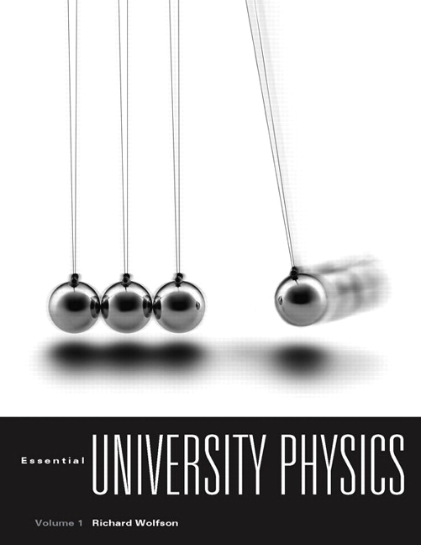
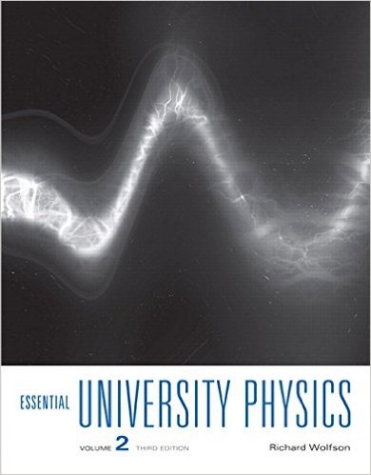
Physics 2048C: Textbook
Richard Wolfson:
Essential University Physics
Volume 1 (3rd Edition)
Simple and to the point
Useful Chapter summaries
Plenty of practice problems
1st/2nd Edition OK
Vol. 2 for PHY2049

Slide 4
Physics 2048C Online
We will use LONCAPA: loncapa.fsu.edu
This is where you will find a link to the online system for the homework and the labs.
Also find links in Blackboard (campus.fsu.edu).

Slide 5
Recitations
I will be assisted by two graduate TAs
Practice problem solving; this will help on exams
Working alone not always best preparation for exams
Explaining your thinking to others can be a big help
Can learn different/efficient problem solving techniques
Proper participation in recitations helps exam scores
Participation worth 5% of final course grade
You will work in groups of 3
You will be assigned 1 problem to present each class
I will select groups to present at random
2.5% for presenting solutions in class
2.5% for coming to class prepared; TAs will check work
I will give short primers at start of each class

Slide 6
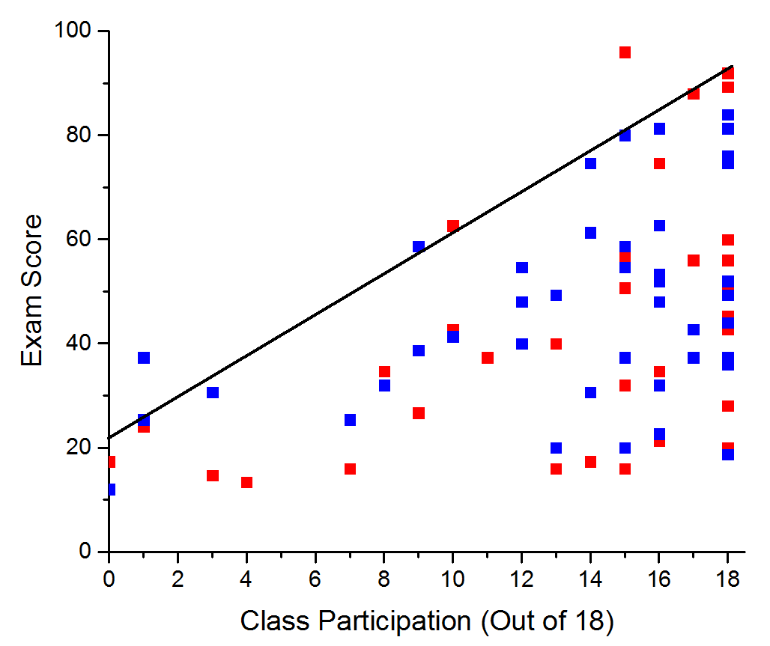
Participation in Recitations Actually Helps

Slide 7
Physics 2048C: This Week and Next
You MUST enroll in the lab course – PHY 2049L
No lab meetings this week and next
There will be an online Excel lab exercise next week
Normal weekly lab meetings will begin during week of Jan. 23
One LONCAPA assignment due this week (Fri)
First assignment mainly review (not covered in lecture)
Very strict deadline of 11:59:59 pm on due date
In general, assignments due each Mon. and Wed. @ 11:59pm
See syllabus and LONCAPA for subsequent deadlines
No excuse for not scoring 100% on LONCAPA
First 20 minute Mini-Exam next week (Jan. 19)

